Slide 1

6th Grade Math
Unit 3, Lesson 9 Solving Multi Step, Real-World Problems with Fractions or Decimals – Part 2 Volume 1, pg. 128

Slide 2


Benchmark
MA.6.NSO.2.3
Solve multi-step, real-world problems involving any of the four operations with positive multi-digit decimals or positive fractions, including mixed numbers.
volume 1, pg. 128

Slide 3
Integrated Mathematical Thinking and Reasoning Standards
MA.K12.MTR.5.1 Use patterns and structure to help understand and connect mathematical concepts.
MA.K12.MTR.6.1 Assess the reasonableness of solutions.
MA.K12.MTR.7.1 Apply mathematics to real-world contexts.
volume 1, pg. 128

Slide 4

Learning Target
I can solve multi-step, real-world problems involving any of the four operations with decimals or fractions.
volume 1, pg. 128

Slide 5

Warm-Up
volume 1, pg. 128

Slide 6
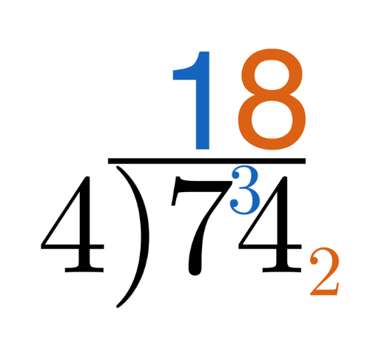
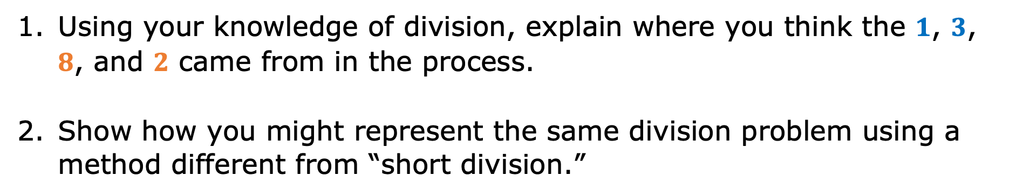
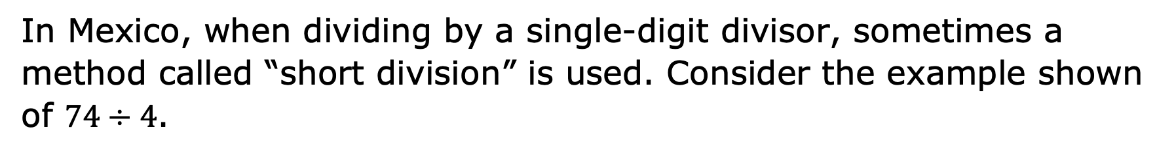
3.9.1 Warm-Up: Short Division
In Mexico, when dividing by a single-digit divisor, sometimes a method called “short division” is used. Consider the example shown of $74÷4$.
Using your knowledge of division, explain where you think the $1$, $3$, $8$, and $2$ came from in the process.
Show how you might represent the same division problem using a method different from “short division.”
volume 1, pg. 128

Slide 7

Collaboration
volume 1, pg. 129

Slide 8

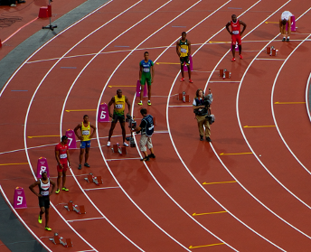
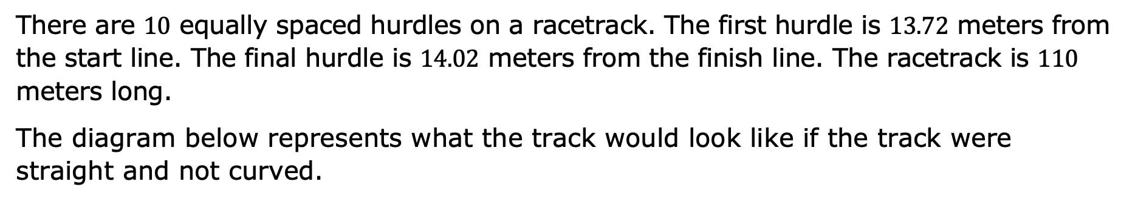
3.9.2 Collaboration: Distance Between Two Hurdles
There are $10$ equally spaced hurdles on a racetrack. The first hurdle is $13.72$ meters from the start line. The final hurdle is $14.02$ meters from the finish line. The racetrack is $110$ meters long.
The diagram below represents what the track would look like if the track were straight and not curved.
volume 1, pg. 129

Slide 9
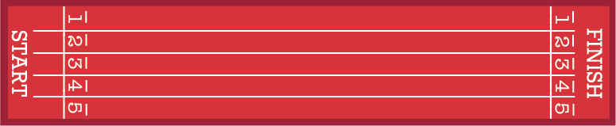
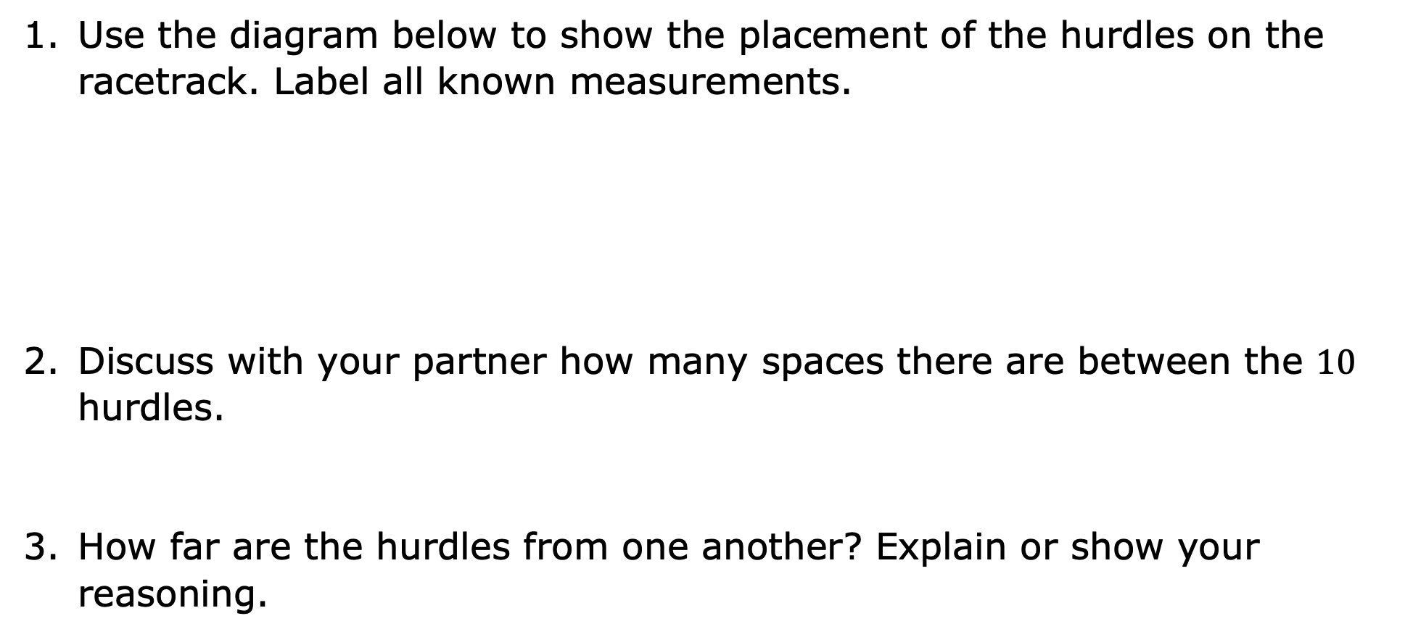
Use the diagram below to show the placement of the hurdles on the racetrack. Label all known measurements.
Discuss with your partner how many spaces there are between the $10$ hurdles.
How far are the hurdles from one another? Explain or show your reasoning.
volume 1, pg. 129

Slide 10
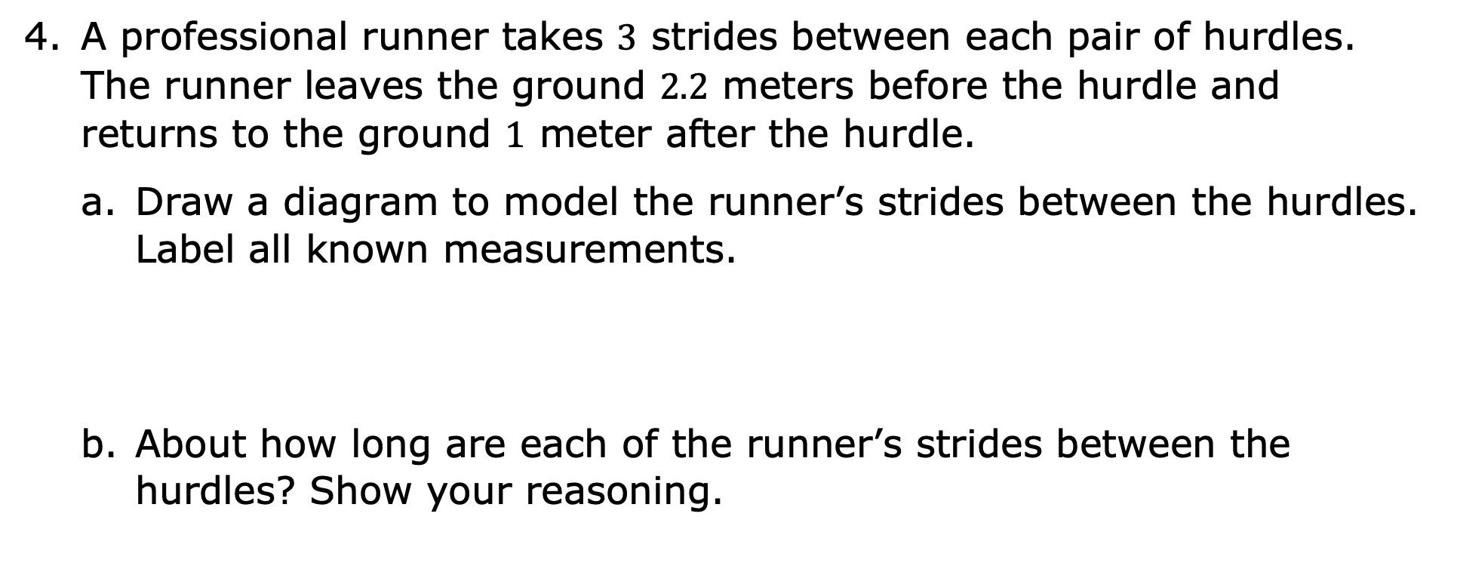
A professional runner takes $3$ strides between each pair of hurdles. The runner leaves the ground $2.2$ meters before the hurdle and returns to the ground $1$ meter after the hurdle.
Draw a diagram to model the runner’s strides between the hurdles. Label all known measurements.
About how long are each of the runner’s strides between the hurdles? Show your reasoning.
volume 1, pg. 129

Slide 11

Your Turn
volume 1, pg. 130

Slide 12
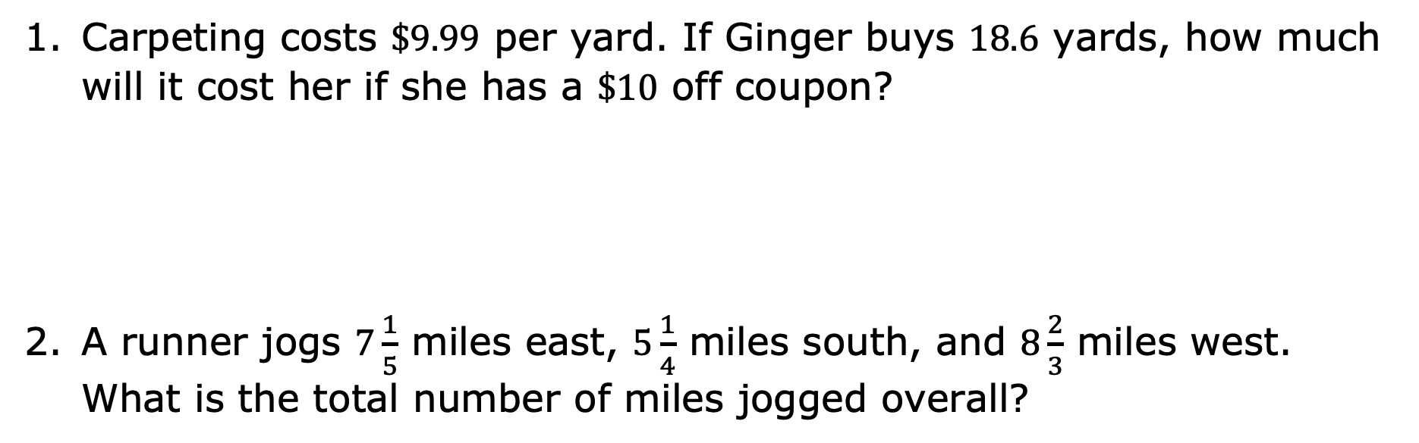
3.9.3 Your Turn!
Carpeting costs $\$9.99$ per yard. If Ginger buys $18.6$ yards, how much will it cost her if she has a $\$10$ off coupon?
A runner jogs $7\frac{1}{5}$ miles east, $5\frac{1}{4}$ miles south, and $8\frac{2}{3}$ miles west. What is the total number of miles jogged overall?
volume 1, pg. 130

Slide 13
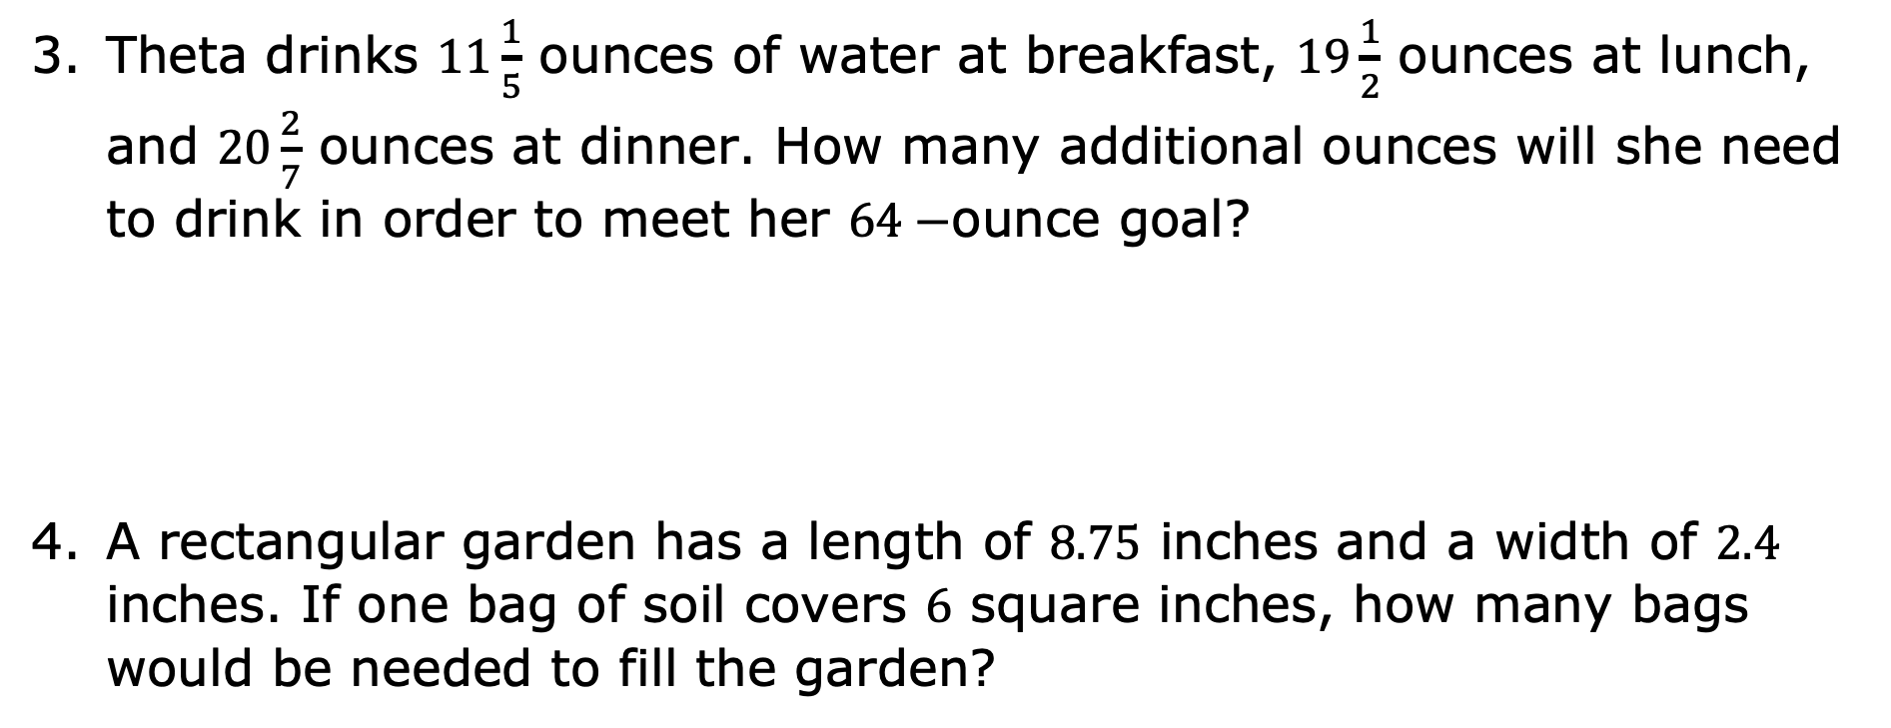
Theta drinks $11\frac{1}{5}$ ounces of water at breakfast, $19\frac{1}{2}$ ounces at lunch, and $20\frac{2}{7}$ ounces at dinner. How many additional ounces will she need to drink in order to meet her $64−$ounce goal?
A rectangular garden has a length of $8.75$ inches and a width of $2.4$ inches. If one bag of soil covers $6$ square inches, how many bags would be needed to fill the garden?
volume 1, pg. 130

Slide 14
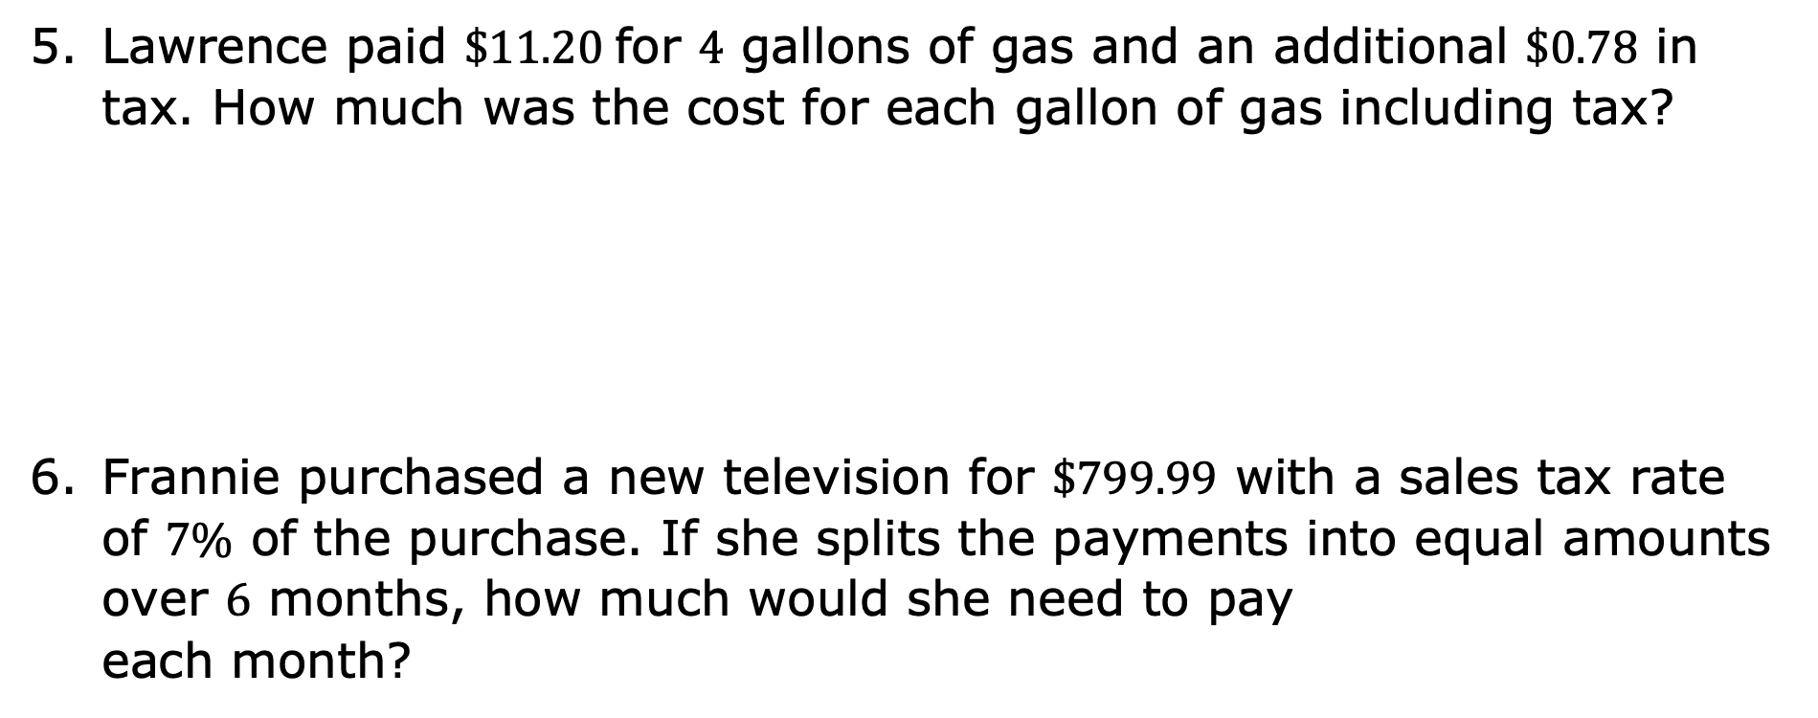
Lawrence paid $\$11.20$for $4$ gallons of gas and an additional $\$0.78$ in tax. How much was the cost for each gallon of gas including tax?
Frannie purchased a new television for $\$799.99$ with a sales tax rate of $7\%$ of the purchase. If she splits the payments into equal amounts over $6$ months, how much would she need to pay each month?
volume 1, pg. 131

Slide 15
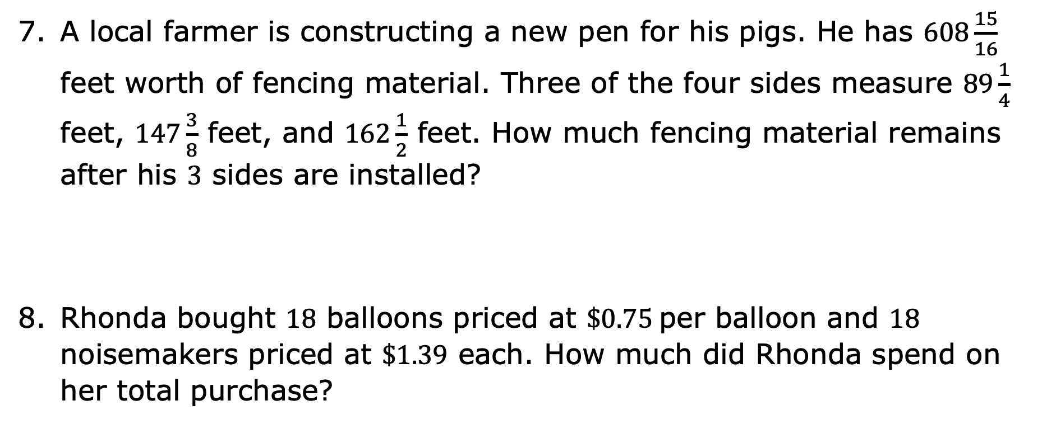
A local farmer is constructing a new pen for his pigs. He has $608\frac{15}{16}$ feet worth of fencing material. Three of the four sides measure $89\frac{1}{4}$ feet, $147\frac{3}{8}$ feet, and $162\frac{1}{2}$ feet. How much fencing material remains after his $3$ sides are installed?
Rhonda bought $18$ balloons priced at $\$0.75$ per balloon and $18$ noisemakers priced at $\$1.39$ each. How much did Rhonda spend on her total purchase?
volume 1, pg. 131

Slide 16

Wrap-Up
volume 1, pg. 132

Slide 17
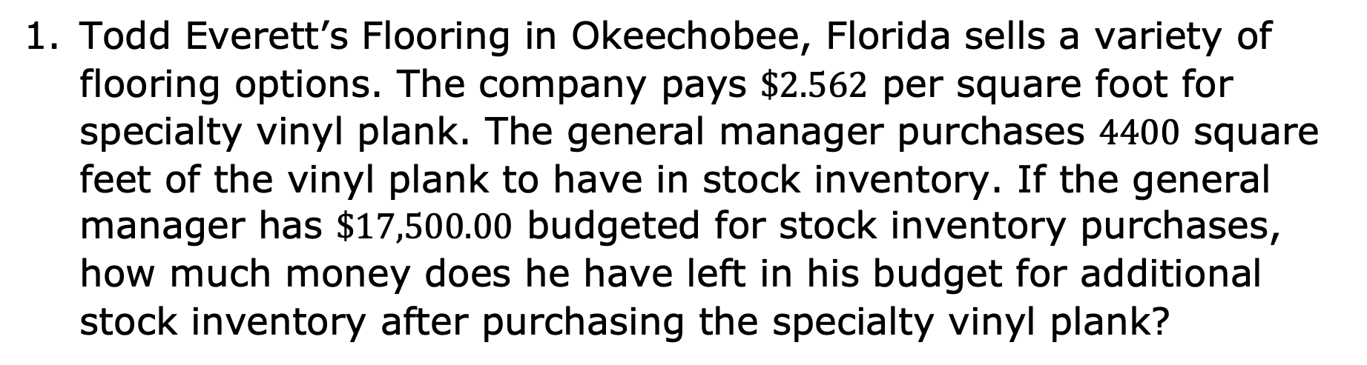
3.9.4 Wrap-Up: Ticket Out the Door
Todd Everett’s Flooring in Okeechobee, Florida sells a variety of flooring options. The company pays $\$2.562$ per square foot for specialty vinyl plank. The general manager purchases $4400$ square feet of the vinyl plank to have in stock inventory. If the general manager has $\$17,500.00$ budgeted for stock inventory purchases, how much money does he have left in his budget for additional stock inventory after purchasing the specialty vinyl plank?
volume 1, pg. 132

Slide 18
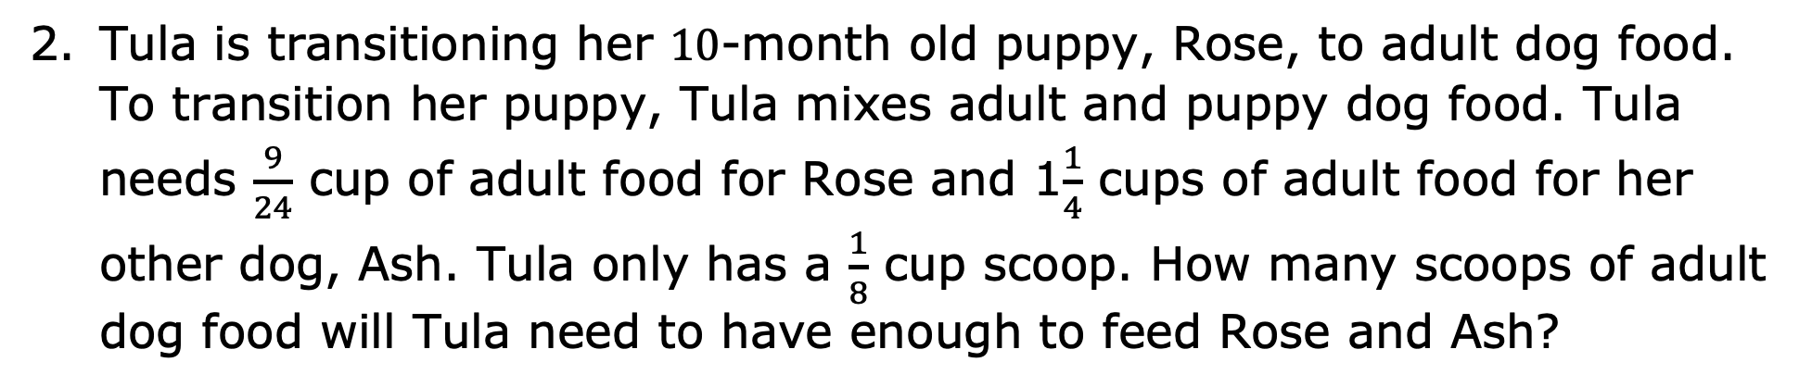
Tula is transitioning her $10$-month old puppy, Rose, to adult dog food. To transition her puppy, Tula mixes adult and puppy dog food. Tula needs $\frac{9}{24}$ cup of adult food for Rose and 1$\frac{1}{4}$ cups of adult food for her other dog, Ash. Tula only has a $\frac{1}{8}$ cup scoop. How many scoops of adult dog food will Tula need to have enough to feed Rose and Ash?
volume 1, pg. 132

